Slide 1
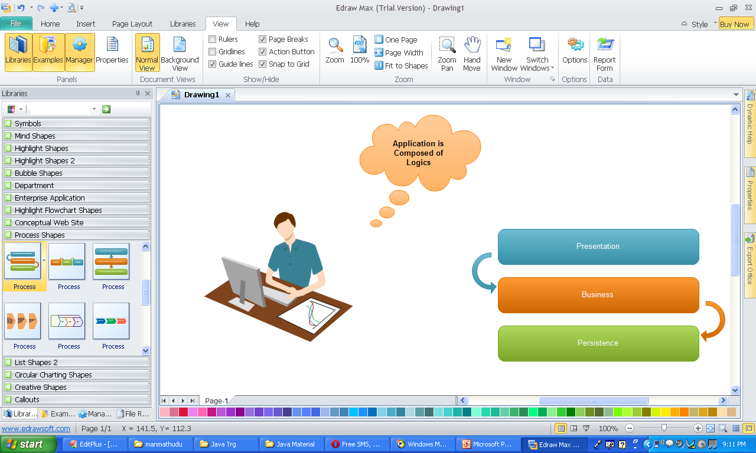

Slide 2
Single Tier Application
Client tier
Application Clients
Web Clients
+ Simple, Faster, Secured
- No N/W, Modification is Difficult, Data Lost is Lost

Slide 3

Two tiered Applications
Client tier
Application Clients
Web Clients
EIS tier

Slide 4




Distributed Multitiered Applications
Client tier
Application Clients
Web Clients
Servlets
JSP/JSF Pages
Web tier
Enterprise Beans
Web Services
Business tier
Entities
Persistence tier
EIS tier

Slide 5
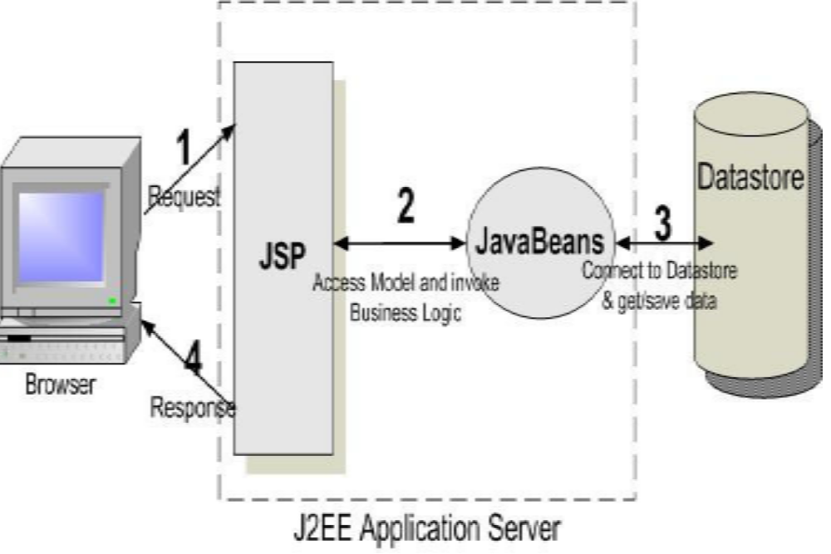

Slide 6
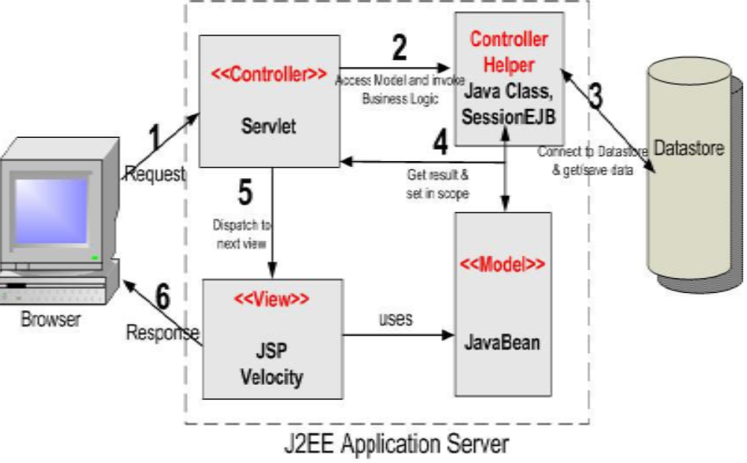

Slide 7
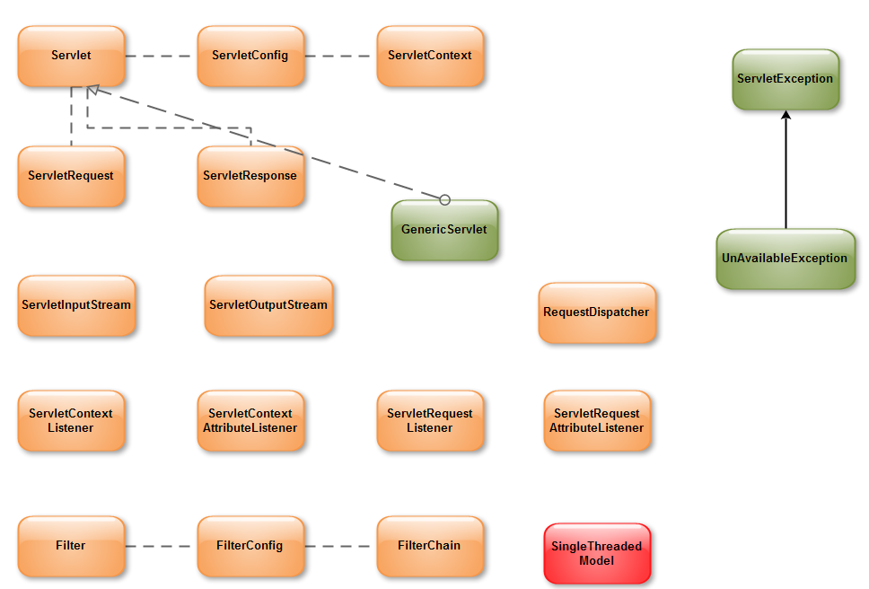
javax.servlet.*;

Slide 8
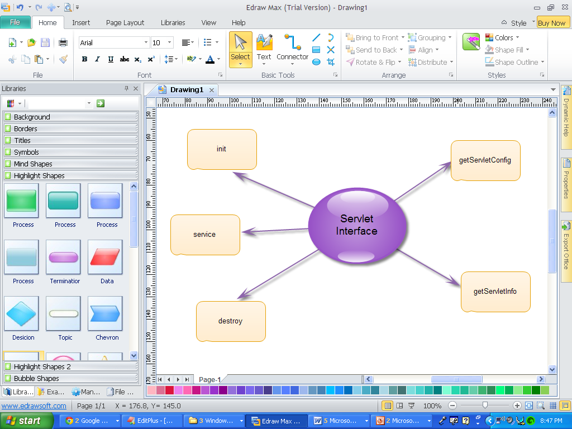

Slide 9
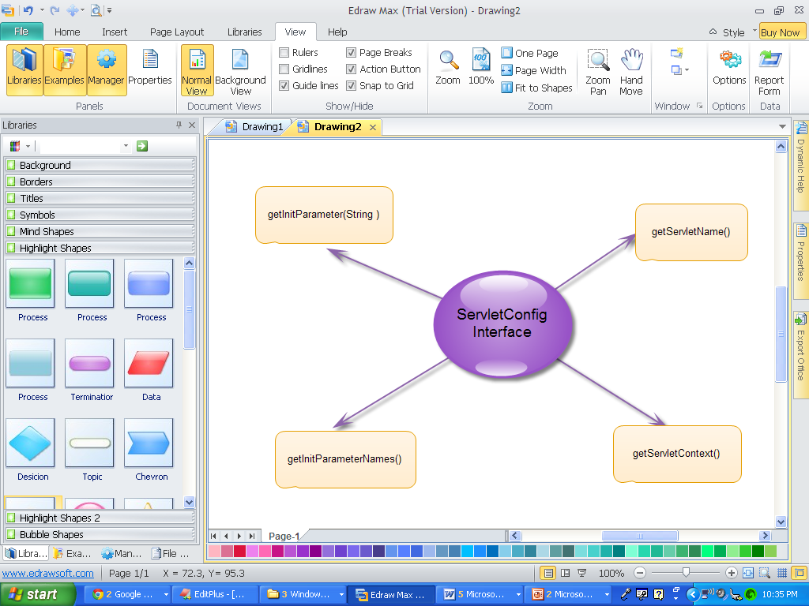

Slide 10
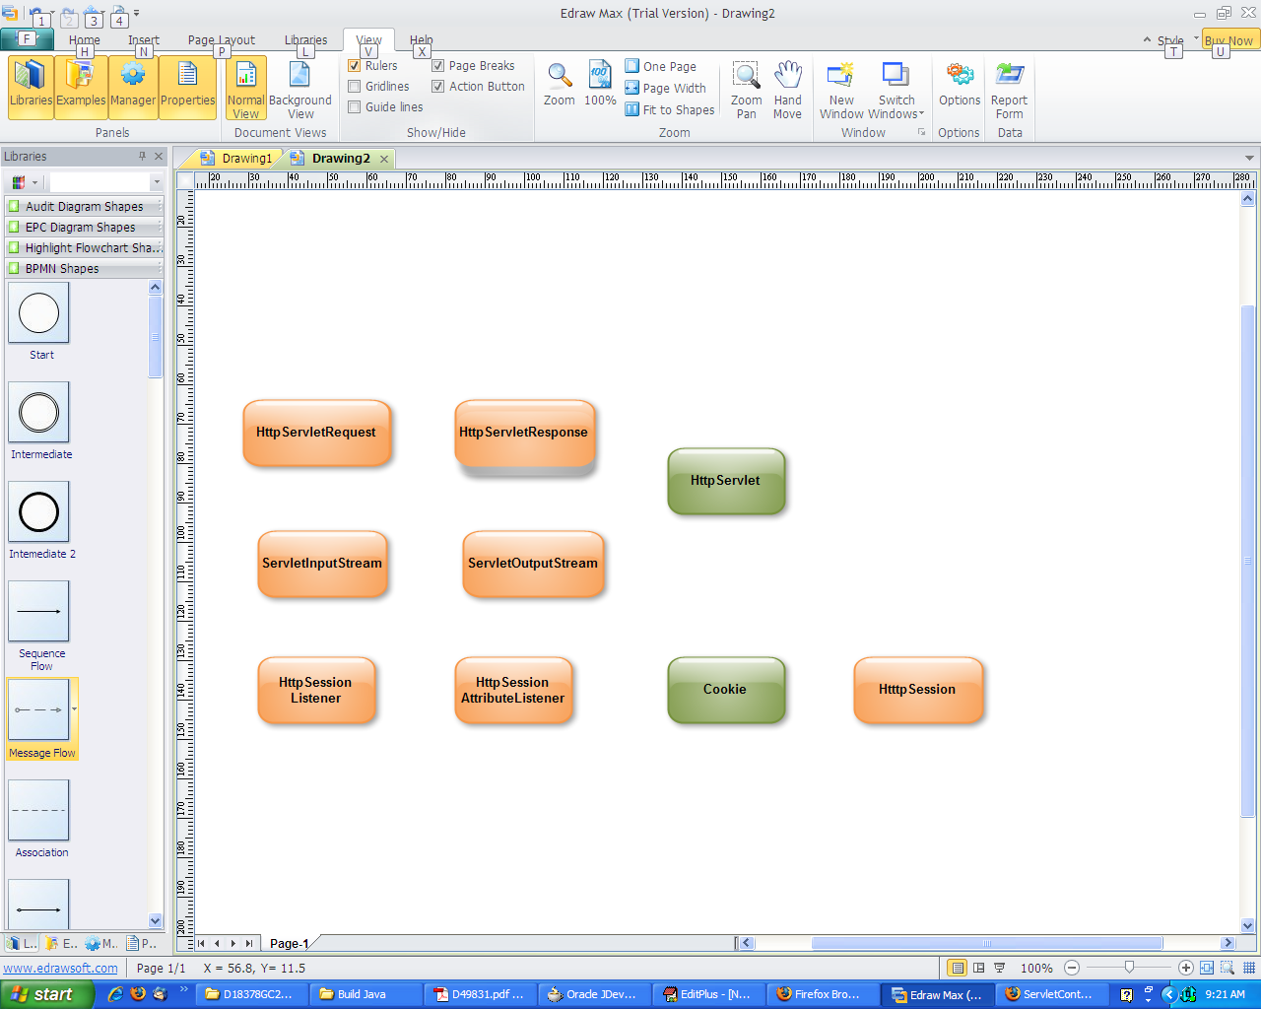
javax.servlet.http.*

Slide 11
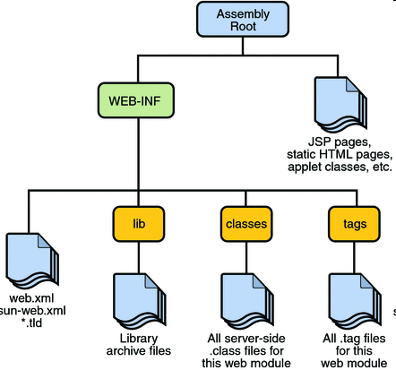
Web Structure of JEE Applications

Slide 12
Web Tier
Servlet Container
Client
Servlet
Response
Servlet
Config
Servlet
Context
Servlet
Request
Server Memory

Slide 13
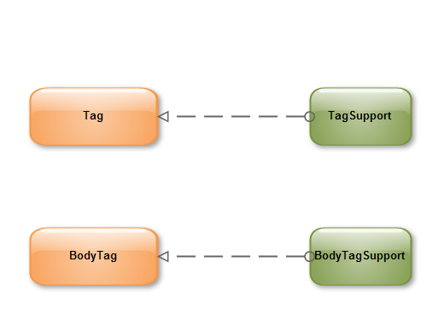
javax.servlet.jsp.tagext.*;

Slide 14
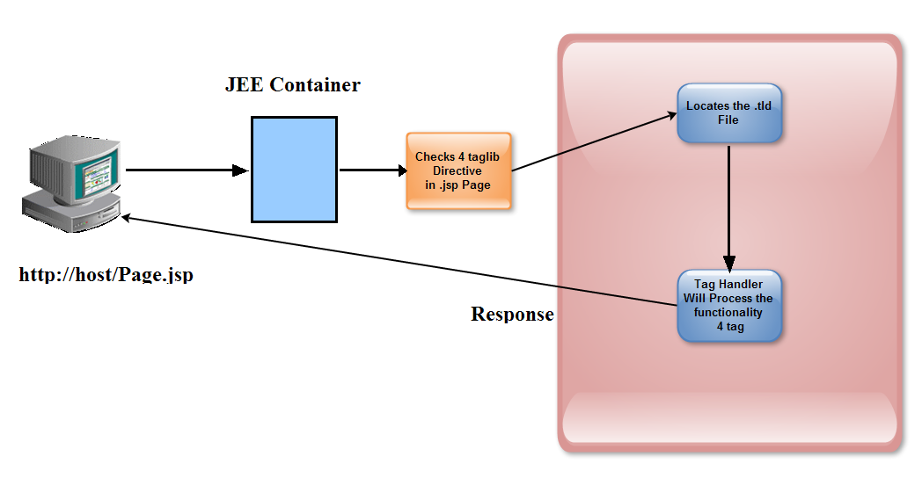

Slide 15


JSF Architecture
HTML
browser
Front
controller
Page
Back-end
code
HTML render kit
Page
Phone/
PDA
WML render kit
Notes:
Oracle Fusion Middleware 11g: Build Java EE Applications 11 - <number>
JSF Architecture (continued)
The slide shows the JSF architecture in a simplified manner. Just like any other MVC-based architecture, JSF architecture has its own front controller called the FacesServlet. The FacesServlet acts as a gatekeeper for the application. Upon an initial Web request to access a JSF application, the FacesServlet handles the request by first preparing the JSF context, which is a Java object that holds all application data.
As stated earlier, a JSF page is made of a tree of UI components that can be associated with model objects called backing beans. These backing beans handle application or business logic for the application.
JSF UI components have the ability to render themselves differently depending on the client type viewing the component. When a page has to be rendered to a particular client type, whether the client type is an HTML browser running on a desktop or a Wireless Markup Language (WML) browser running on a wireless phone, a particular renderer is used for displaying the data maintained in the UI components. Because JSF decouples the UI component from its rendering logic, the same UI component is used for displaying information about different client types using different protocols.

Slide 16
JSF Component Architecture
Markup
Device Renderer
<f:view>
…
<h:inputText
required="true"
value="#{emp.name}"
/>
…
</f:view>
UI component
Expr. Language
JSF page
Managed bean
J2EE Persistence Layer/JDBC
RDBMS
Notes:
Oracle Fusion Middleware 11g: Build Java EE Applications 11 - <number>
JSF Component Architecture
In this diagram, all the three main JSF components are highlighted: the component renderer, the component itself, and the binding expression.

Slide 17
JSF Life Cycle: Initial Request
Client/Browser
Restore/create
view.
Apply
request
values.
Process
validation.
Render
response.
Invoke
application.
Update
model.
Notes:
Oracle Fusion Middleware 11g: Build Java EE Applications 11 - <number>
JSF Life Cycle: Initial Request
The life cycle handles both kinds of requests—initial requests and postbacks. An initial request for a page is when the user requests the page for the first time.
During the initial request, JSF creates a server-side component tree based on the components on the page. It populates the tree with whatever values are appropriate at the time. Because this is an initial request with no user input or actions to process, JSF executes only the restore view and render response phases.

Slide 18
JSF Life Cycle: Postback
Client/Browser
Restore/create
view.
Apply
request
values.
Process
validation.
Render
response.
Invoke
application.
Update
model.
Notes:
Oracle Fusion Middleware 11g: Build Java EE Applications 11 - <number>
Life Cycle: Postback
A postback occurs when the user submits the form contained on a page that was previously loaded into the browser as a result of executing an initial request. When the life cycle handles a postback, it executes all the phases.
Apply request values: Components that hold a value, such as input fields, have their values applied to their counterparts in the view tree. Events such as ValueChangeEvents (VCE) or ActionEvents (AE) are queued for processing later at the end of this phase. A VCE means that a value has changed for a specific UI component. An AE means that a button (or any UI component that is a source of an action) was clicked.
Process validation: Validation and conversion logic is executed for each component (both
built-in validation and data conversion, or custom validation and conversion added onto the components). If a validation error occurs, an error is reported, the life cycle halts, and the response is rendered with validation error messages.
Update model: Any managed bean properties that are bound to UI components by using the Value attribute are updated with the value of the component.

Slide 19
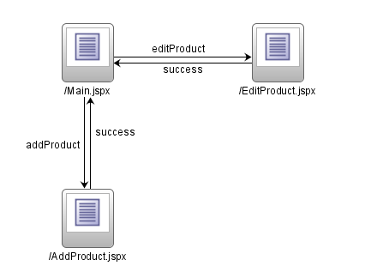
JSF Navigation Diagram
Notes:
Oracle Fusion Middleware 11g: Build Java EE Applications 11 - <number>
JSF Navigation Diagram
JDeveloper includes a Visual Editor or diagrammer for the JSF navigation model, which you can also edit directly in XML. The diagram in the slide depicts a series of rules, which are named events that link pages (or views in JSF) together. If a command item, such as a button on the Main page, raises an editProduct outcome, then the JSF framework acts as a page flow controller to forward (or redirect, if required) the browser to the EditProduct page.
This is an example of where good tooling for JSF can make a real difference. Rendering the navigation model as a diagram and enabling visual editing gives the developer both a productive way of defining the application page flow and a visual document of the application page structure and relationships.
If the application flow needs to change—for example, if a page needs to be added—then the relationships in this diagram can be redrawn, but the pages themselves do not have to be touched. This is an implementation of the JSP Model 2 Architecture as pioneered by the Struts framework.

Slide 20
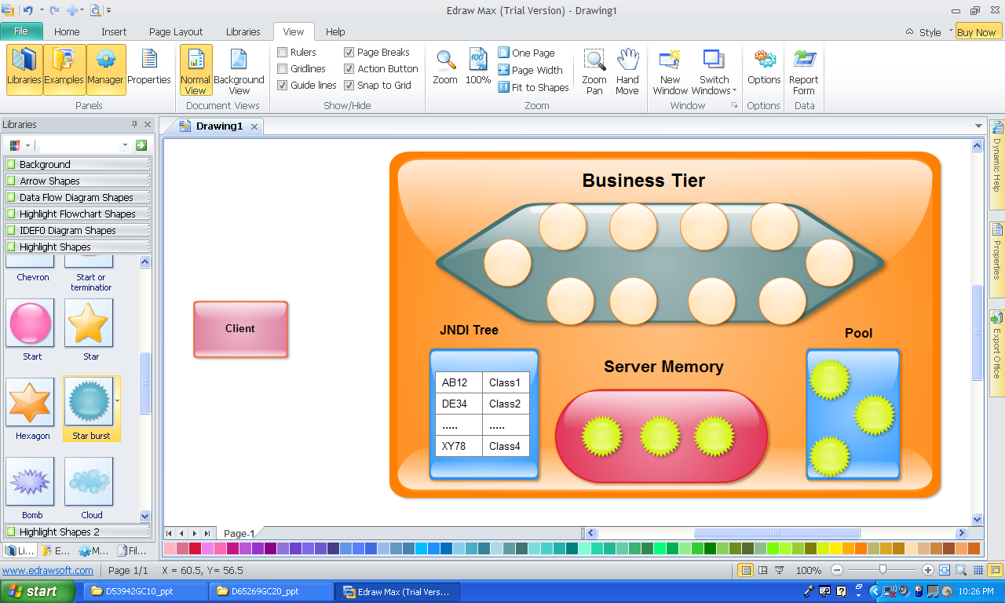

Slide 21
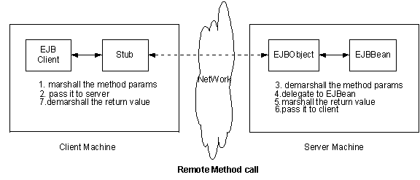

Slide 22
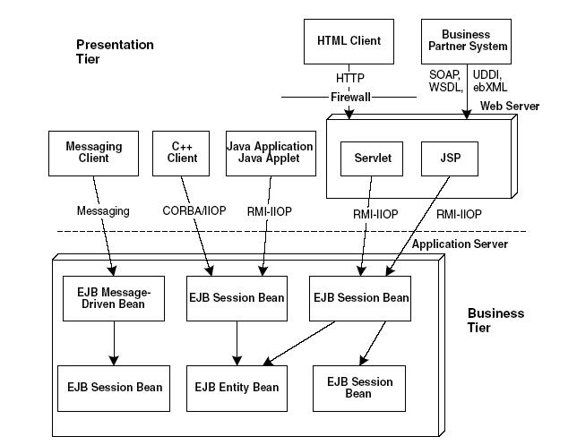

Slide 23
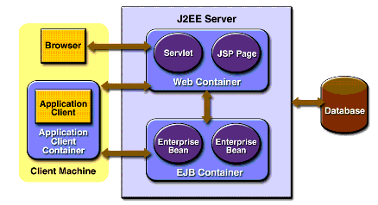
EJB Architecture
  EJBs are JEE components that run in EJB container within an Application Server.
  Although transparent to application developers, EJB containers provide services (security, transactions) to its EJB’s.

Slide 24


Enterprise Application Tiers
Entity Classes
TransactionLog
Client
Session Bean
AutomaticTeller
ATMCustomer
Client
Ledger
Session Bean
Database
BranchTeller
Account
Client
Customer
Client

Slide 25
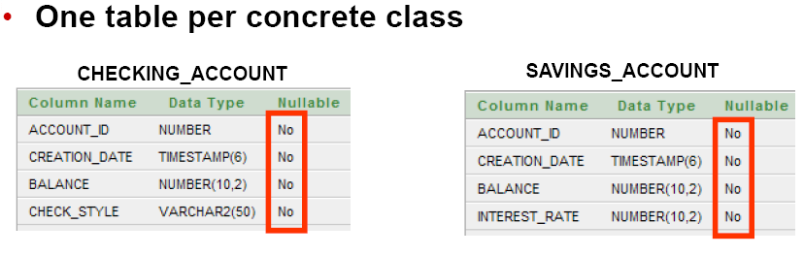
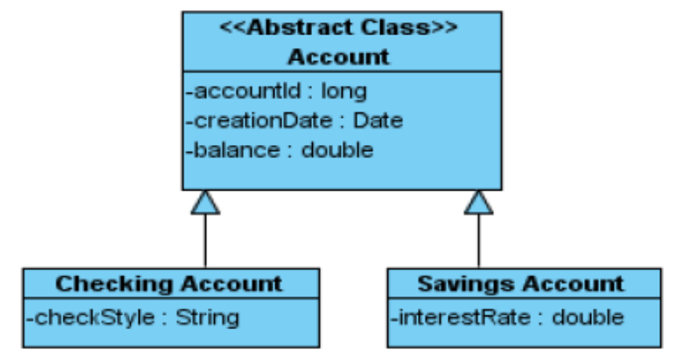

Slide 26
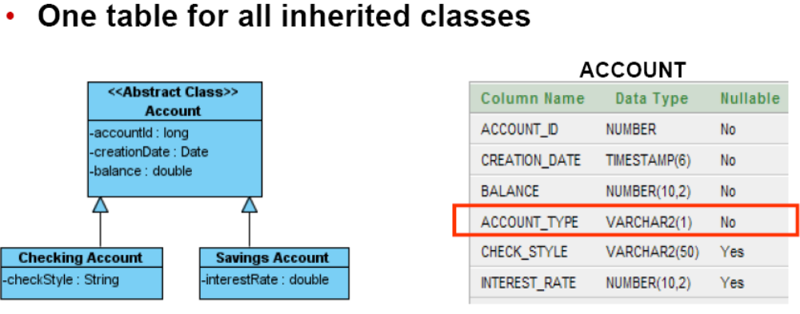
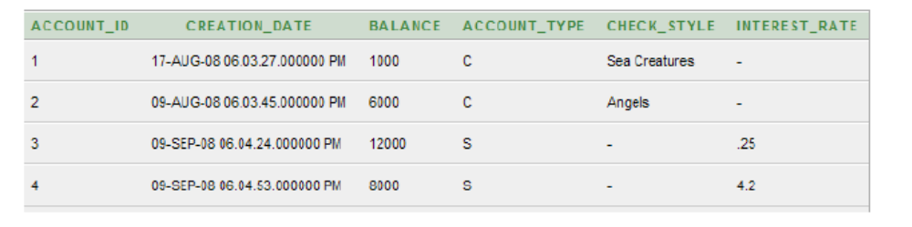

Slide 27
